Slide 1


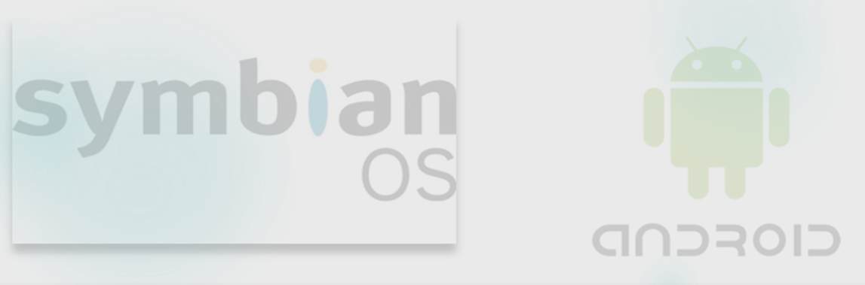



Switching and Multi-Homing Costs
Symbian
Android
Android
Licensing fee
Fragmented app/ecosystem community - porting apps across platforms was difficult
Multiple UIs, which were not compatible
Key differences compared to PC archetype
Companies that deal with Android never had to pay a license fee to the company for using the platform.
Single storefront, easy to buy apps
Android has standard UI from start
Android emulated PC capabilities

Slide 2
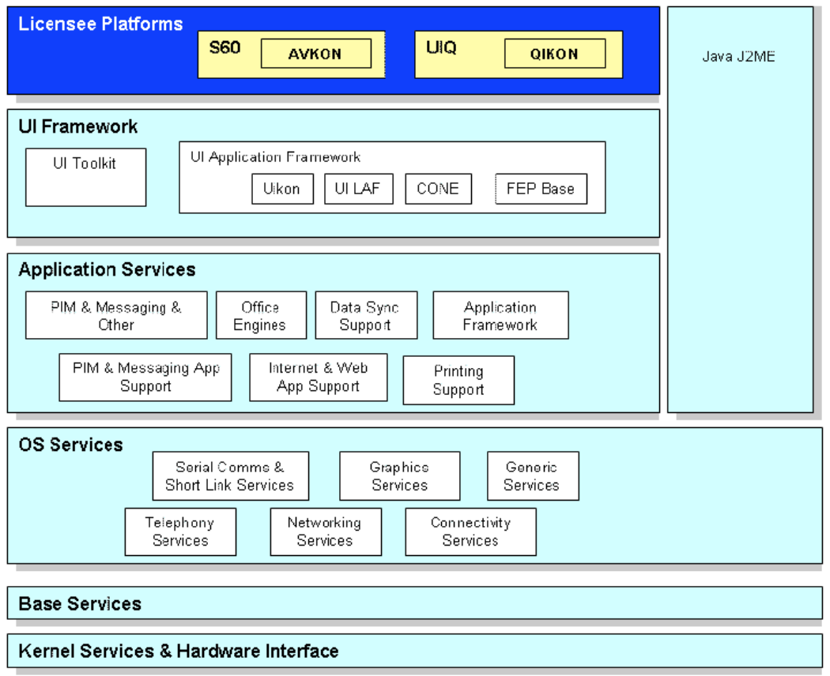
Switching and Multi-Homing Costs
Symbian
Android
Android
No direct relationship with customers – software upgrades not available with old phones
UIQ interface – stylus based input method
Browser compatibility - website compatibility comparable to a desktop browser
Upgrades were easily available
Touch based
Android used WebKit, far before Symbian launched Opera
The structure of Symbian OS

Slide 3
References:
Web links
Android
http://citeseerx.ist.psu.edu/viewdoc/download?doi=10.1.1.721.9498&rep=rep1&type=pdf
http://disruptivewireless.blogspot.com/2008/07/nokia-series-40-6th-edition.html
https://www.theverge.com/2016/9/30/13119924/blackberry-failure-success
https://www.zdnet.com/article/android-before-android-the-long-strange-history-of-symbian-and-why-it-matters-for-nokias-future/
https://www.gartner.com/en/newsroom/press-releases/2017-02-15-gartner-says-worldwide-sales-of-smartphones-grew-7-percent-in-the-fourth-quarter-of-2016
https://www.businessinsider.com/android-iphone-market-share-2011-4
https://www.statista.com/statistics/266219/global-smartphone-sales-since-1st-quarter-2009-by-operating-system/

